Slide 1


Science Journalism with UANews:
Treating Chronic Jargon Disease*
Emily Walla
Mentor: Daniel Stolte, University of Arizona Communications
Arizona Space Grant Symposium
Hosted by Arizona State University
April 13, 2019
*Chronic Jargon Disease is not a real medical ailment and nothing said in this presentation should be taken as medical advice.

Slide 2
Chronic Jargon Disease
    CJD is an illness that causes ineffective communication.
    It affects thousands of papers and academics every year.
Notes:
Every year millions of academics are diagnosed with chronic jargon disease, a fatal illness that causes confusion, boredom, disengagement, and inaccessibility. Symptoms of chronic jargon disease include saying, “what?” very quietly under your breath while reading, re-reading paragraphs 8 times, falling asleep, existential crises, and not understanding any science being described. If you or a loved one are an academic, speak with academics, or read academic papers, you may be at risk for chronic jargon disease. When left untreated, chronic jargon disease can sequester academia from the rest of the world, causing catastrophic drops in scientific literacy, resulting in loss of interest in science, loss of scientific funding, and measles outbreaks. If you or your paper suffer from chronic jargon disease, talk to your research group about science communication.

Slide 3
If you or a loved one are an academic, speak with academics or read academic papers, you are at risk for Chronic Jargon Disease

Slide 4
CJD: Long-term Effects
When left untreated, chronic jargon disease can:
  sequester academia from the rest of the world
    catastrophic drops in scientific literacy
      loss of interest in science
      loss of scientific funding
      measles outbreaks.
If you or your paper suffer from chronic jargon disease, talk to your research group about science communication

Slide 5
Treatment for CJD: Science Communication
allows you and your paper to reconnect with simple, straightforward language
helped millions of researchers find media attention
brought complicated science to millions of non-academics

Slide 6
Start your treatment today with your University News Organization

Slide 7
What is Science Communication?
Simple language
Cool Science!
big-picture focus
Making science accessible to
non-scientists

Slide 8
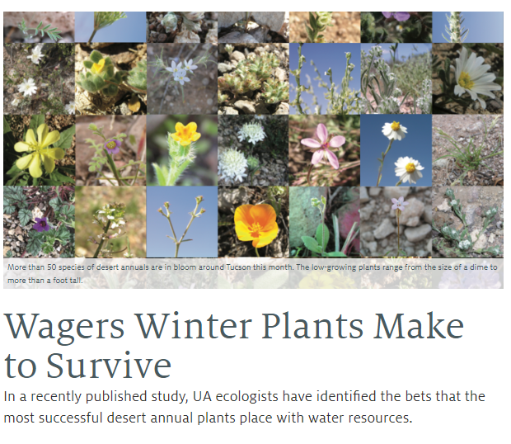
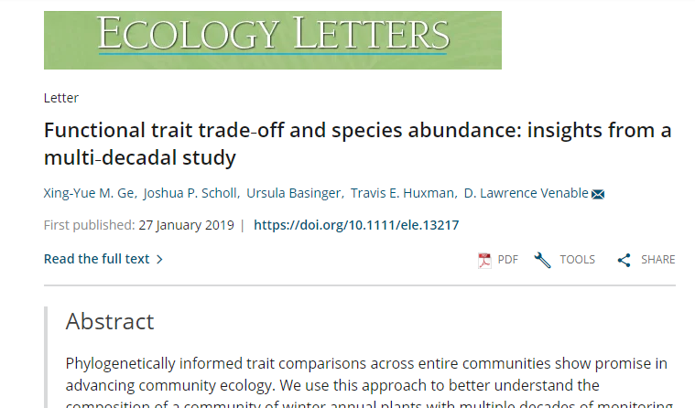
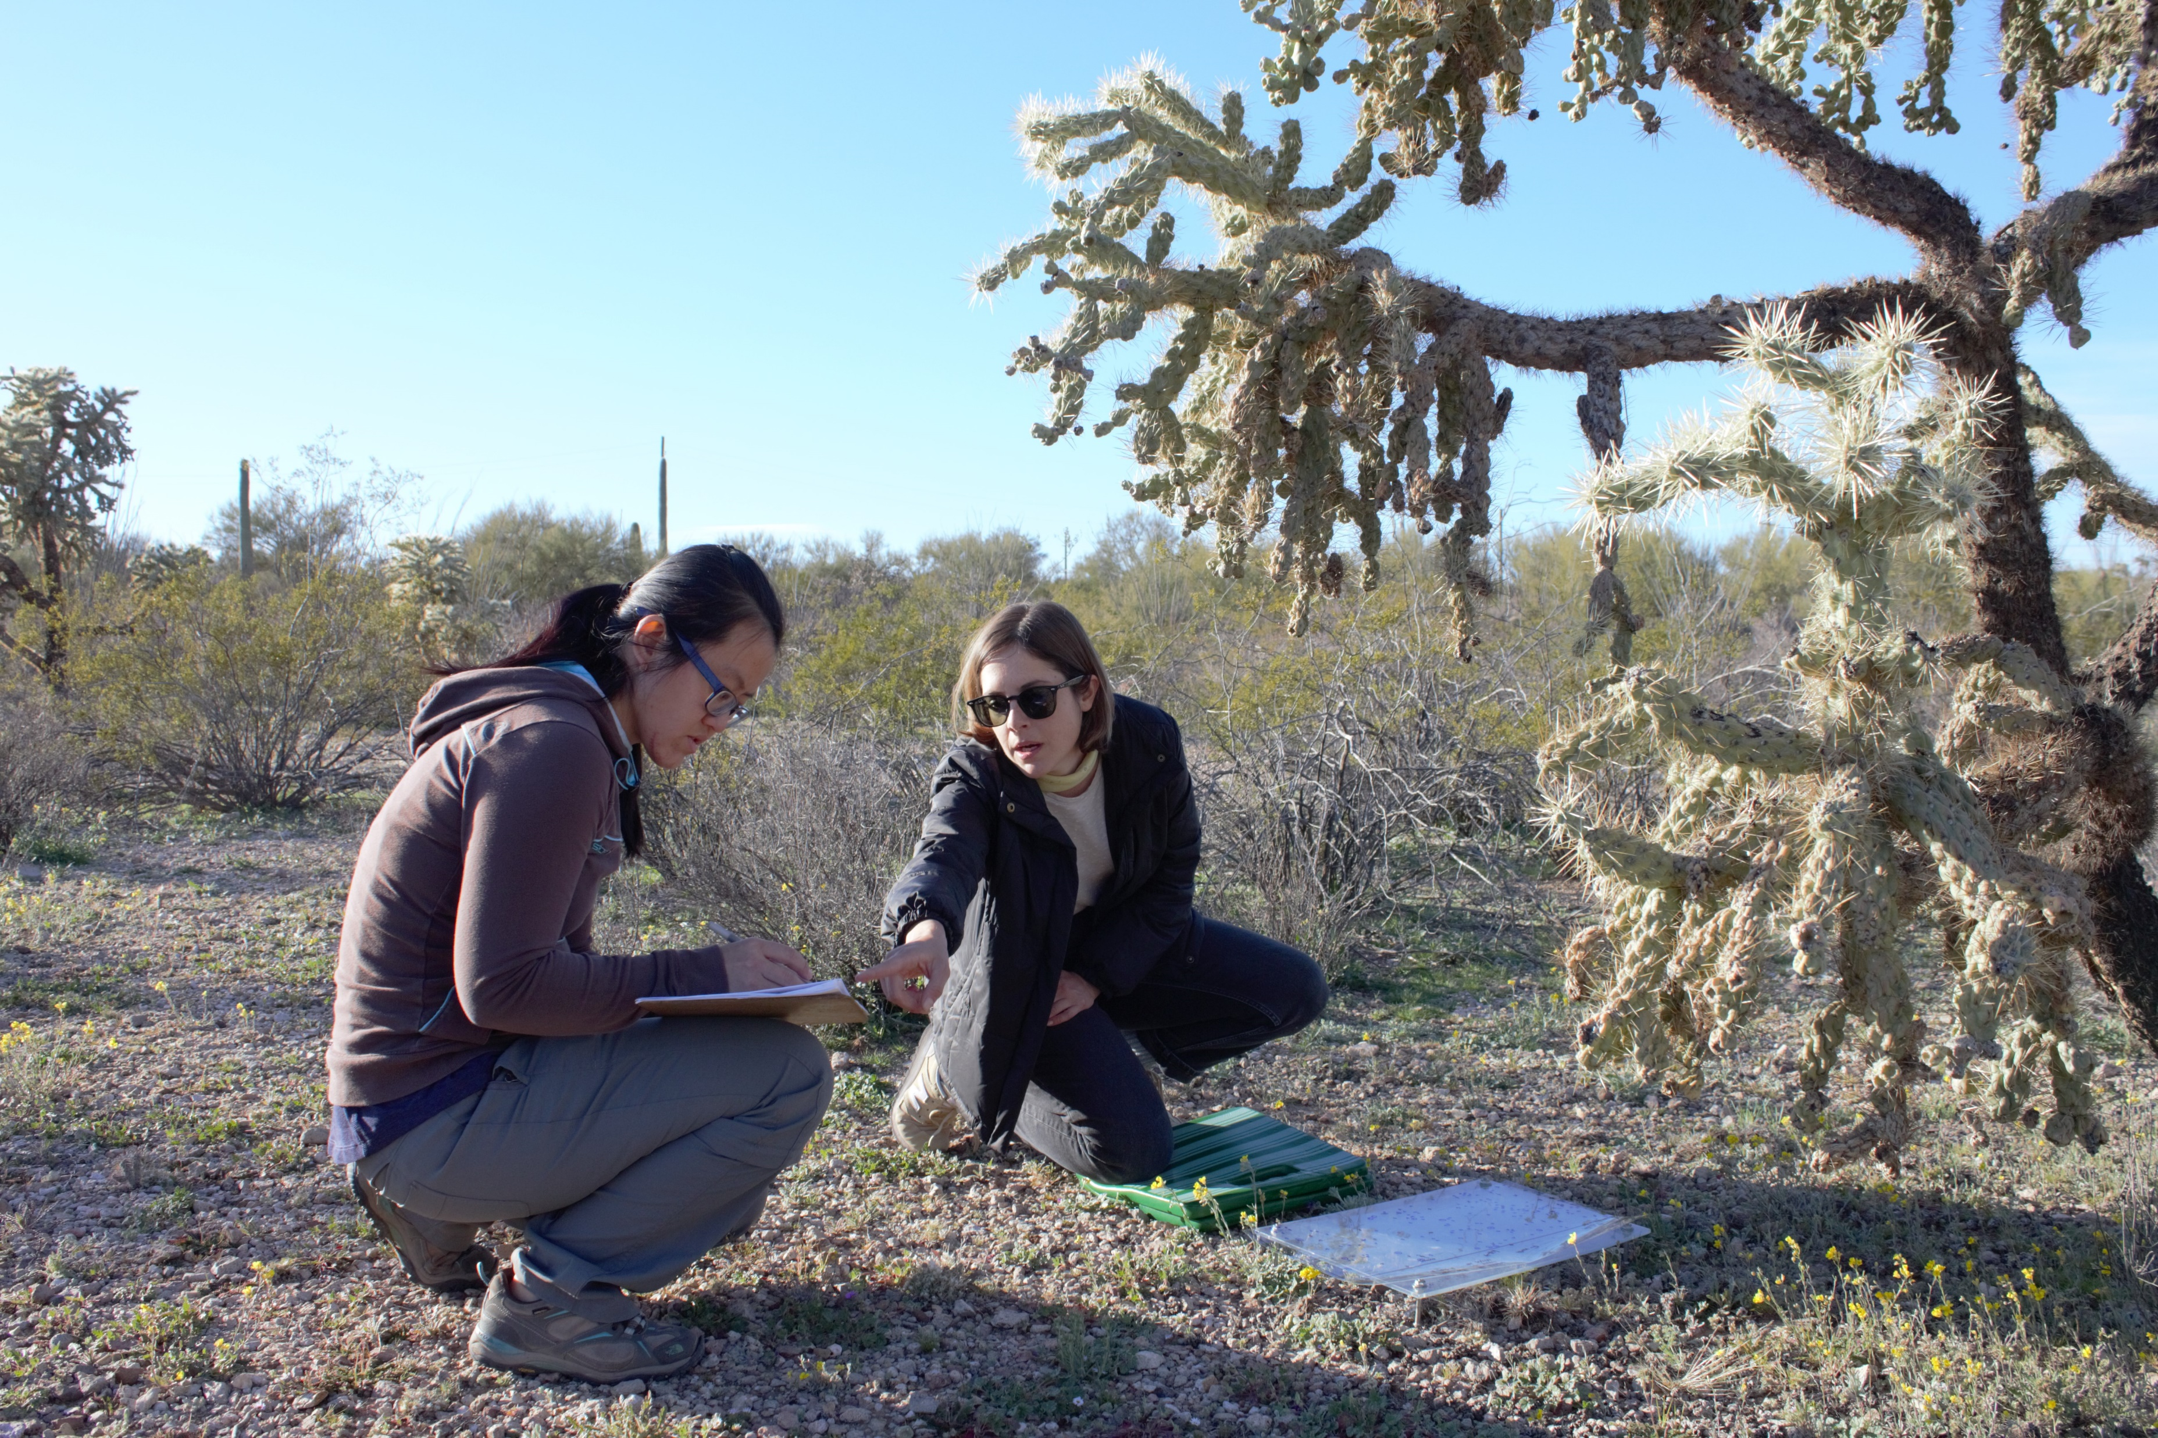


The Writing Process
1. Find a story
2. Do your Research
3. Conduct an Interview
4. Write a Draft
5. Review
6. Publish

Slide 9
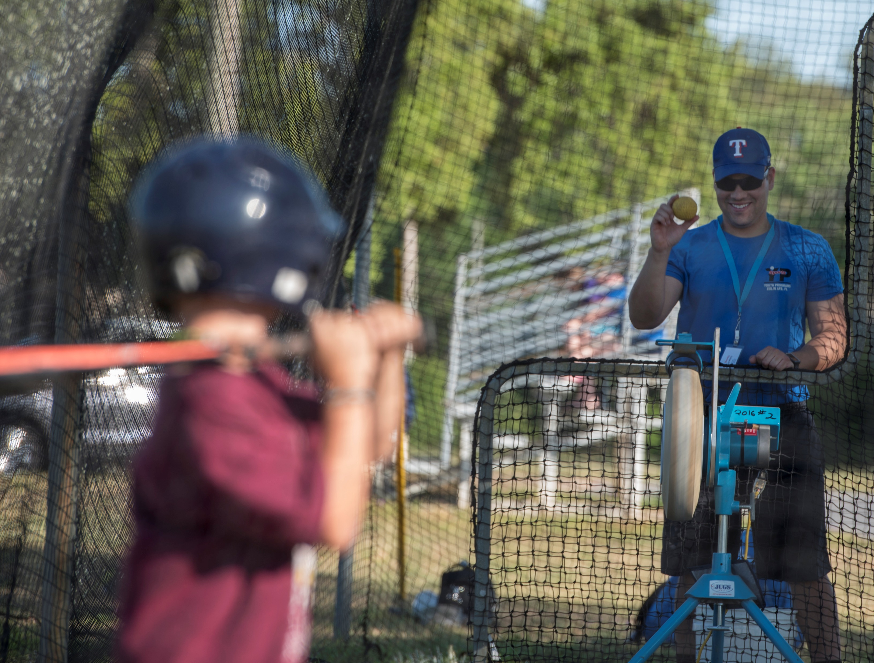
1. Finding a story
Science stories start with scientists!
University news orgs spread the good word of your research
UA Scientists
The Pitch
UA Science Writers
Image Credit: Staff Sgt. Peter Thompson
Convince writers that your
research is worth writing about
Answer the Who (you!), What (results!) and Why of your research

Slide 10
What’s in the Why?
1. Why is this research important or unique?
2. How does this affect the field?
3. How does this affect everyone else?
Knowing the answers to these questions and including them in your pitch will increase your chances of getting a story

Slide 11


3. The Interview
Role of the Science Writer
Be prepared
Play Dumb
Take Notes
Role of the Scientist
Be prepared
Relax (it’s just a conversation)
Be excited!
Notes:
***You have a pic on your phone for this slide***
Come prepared with a list of questions to begin with. Usually I open with, “So, tell me what this research is about,” or “What did you do in the research?”
Play Dumb – even if you can explain a concept flawlessly, ask the researcher about it anyway. That way, you can get some nice quotes and you might learn something.
Take Notes: Taking notes is more important than listening to the scientist. Take Notes and Record, just in case something goes wrong and you lose one of those two things.
Transcribe the interview as soon as you can afterwards. This helps you write the transcription faster and ensures that you have all your material prepared before you begin the draft.

Slide 12
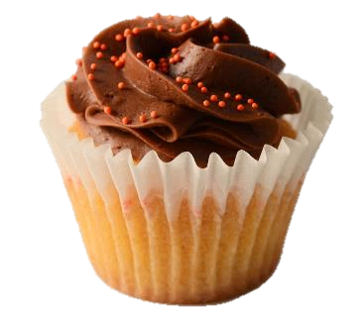
4. The Draft
Who, What, When and Where, and Why it is Newsworthy
Supportive Quote and Important Details
More Info
Notes:
Cupcake: The Headline and Subheadline/Summary and Lede are like the decorations and sprinkles, the questions are like the frosting (the most important part! Otherwise it’s a muffin), and the rest is like the cake part of the cupcake.
While you want people to read your whole article, chances are they will not (people skim, get bored and skip out after a couple of paragraphs), so you want to make sure to get the most important stuff at the top – that way they can read any amount of the article and go “Hey I read this article about butterfly mimics, and apparently some butterfly mimics can actually be the toxic thing!”
I like to try to end with a quote or a thinker statement, something that leaves the reader wanting to read more science articles, but often the driest, most boring stuff about funding and etc gets put at the bottom of the article.

Slide 13
After You Publish
Congrats! You did it!
Get back to writing!
Congrats! Your work is out there!
Be prepared for more press!

Slide 14
Lasting Impacts of Science Communication
For the public
Inspires future scientists
Educate the audience
Improve science literacy
For the scientists
Hones communication skills
Point of pride for institution
$$$

Slide 15
Acknowledgements
The folks University of Arizona Marketing and Communications
All the awesome researchers at UA
The Arizona Space Grant Consortium

Slide 16
Thank You!

